Slide 1
Use Cases
Chapter 3
Systems Analysis and Design in a Changing World 6th Ed

Slide 2
Use Cases
Use case— an activity that the system performs, usually in response to a request by a user
Use cases define functional requirements
Analysts decompose the system into a set of use cases (functional decomposition)
Two techniques for Identifying use cases
  User goal technique
  Event decomposition technique
Name each use case using Verb-Noun
Systems Analysis and Design in a Changing World, 6th Edition

Slide 3
Use Case Models
Use Cases Describe systems functions
Use Cases Describe the interface between users and the system
  What events, initiated by what users cause a function of the system to be initiated?
Models
  Use Case Description (Textual model)
    Brief version - Provides name and brief description for each use case (full version covered in Ch. 5)
  Use case Diagram (Graphical)
    Shows interactions of users (actors) with the use cases of a system
Systems Analysis and Design in a Changing World, 6th Edition

Slide 4
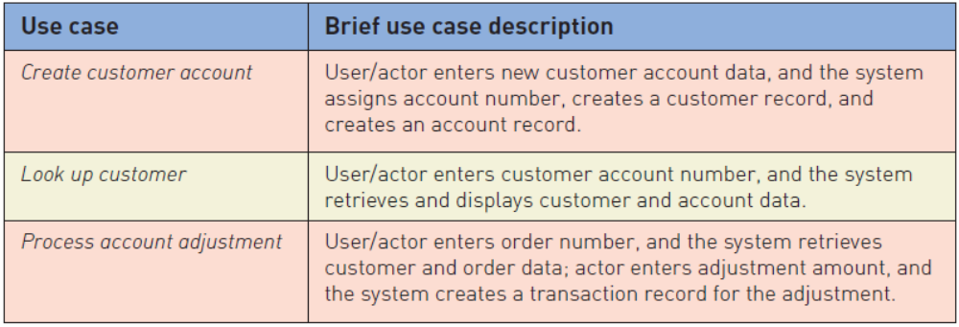
Use Cases and
Brief Use Case Descriptions
Brief use case description is often a one sentence description showing the main steps in a use case
Systems Analysis and Design in a Changing World, 6th Edition

Slide 5
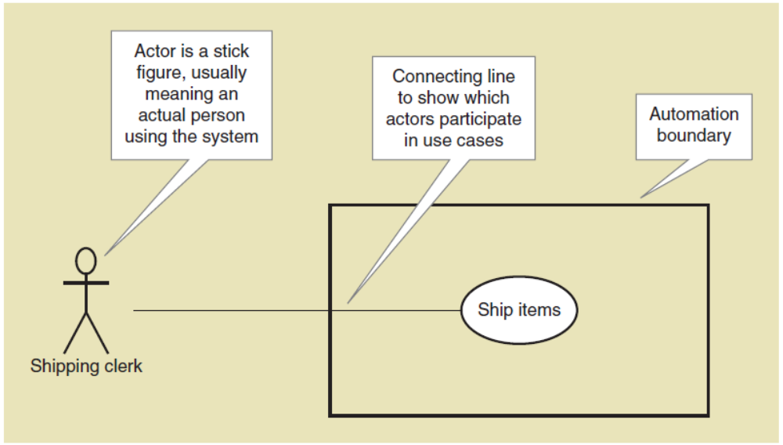
Use Case Diagrams
Symbols
Systems Analysis and Design in a Changing World, 6th Edition

Slide 6
User Goal Technique
This technique is the most common in industry
Identify all of the potential categories of users of the system
Interview and ask them to describe the tasks the computer can help them with
Probe further to refine the tasks into specific user goals, “I need to Ship items, Track a shipment, Create a return”
Systems Analysis and Design in a Changing World, 6th Edition

Slide 7
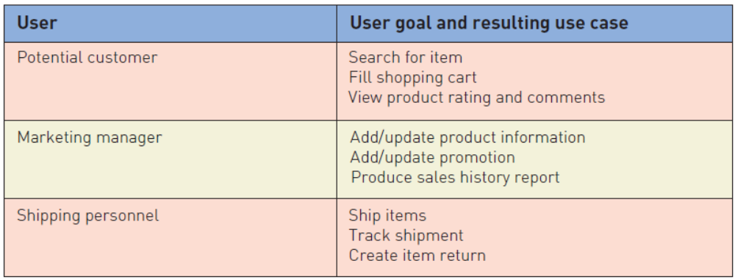
User Goal Technique
Some RMO CSMS Users and Goals
Systems Analysis and Design in a Changing World, 6th Edition

Slide 8
User Goal Technique:
Specific Steps
Identify all the potential users for the new system
Classify the potential users in terms of their functional role (e.g., shipping, marketing, sales)
Further classify potential users by organizational level (e.g., operational, management, executive)
For each type of user, interview them to find a list of specific goals they will have when using the new system (current goals and innovative functions to add value)
Systems Analysis and Design in a Changing World, 6th Edition

Slide 9
User Goal Technique
Specific Steps (continued)
Create a list of preliminary use cases organized by type of user
Look for duplicates with similar use case names and resolve inconsistencies
Identify where different types of users need the same use cases
Review the completed list with each type of user and then with interested stakeholders
Systems Analysis and Design in a Changing World, 6th Edition

Slide 10
Event Decomposition Technique
More Comprehensive and Complete Technique
  Identify the events that occur to which the system must respond.
  For each event, name a use case (verb-noun) that describes what the system does when the event occurs
Event– something that occurs at a specific time and place, can be described, and should be remembered by the system
Systems Analysis and Design in a Changing World, 6th Edition

Slide 11
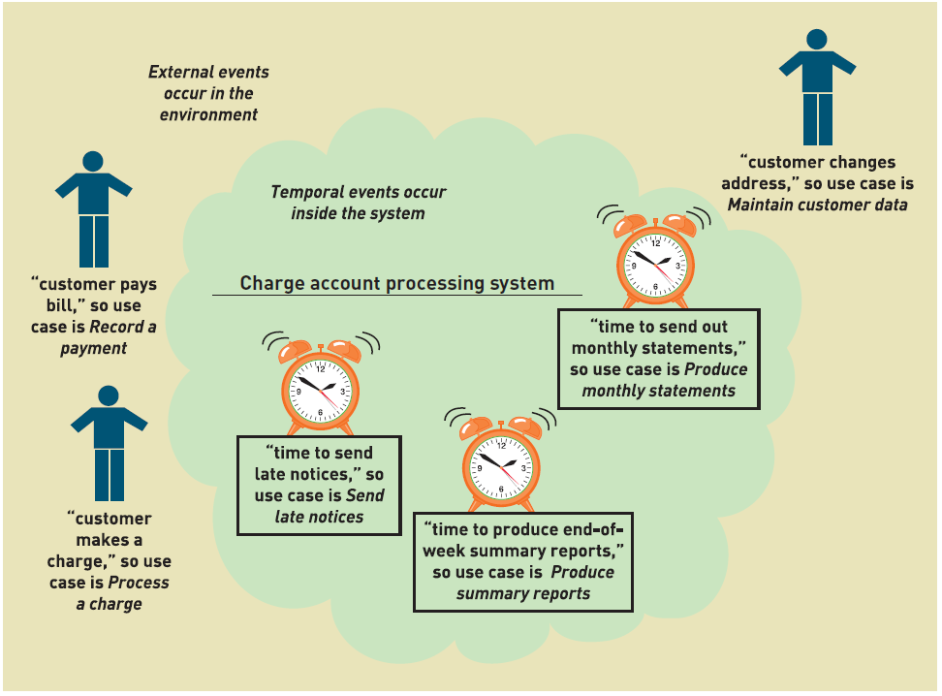
Events and Use Cases
Systems Analysis and Design in a Changing World, 6th Edition

Slide 12
Types of Events
External Event
  an event that occurs outside the system, usually initiated by an external agent or actor
Temporal Event
  an event that occurs as a result of reaching a point in time
State Event
  an event that occurs when something happens inside the system that triggers some process
  reorder point is reached for inventory item
Systems Analysis and Design in a Changing World, 6th Edition

Slide 13
External Event Checklist
External agent or actor wants something resulting in a transaction
  Customer buys a product
External agent or actor wants some information
  Customer wants to know product details
External data changed and needs to be updated
  Customer has new address and phone
Management wants some information
  Sales manager wants update on production plans
Systems Analysis and Design in a Changing World, 6th Edition

Slide 14
Temporal Event Checklist
Internal outputs needed at points in time
  Management reports (summary or exception)
  Operational reports (detailed transactions)
  Internal statements and documents (including payroll)
External outputs needed at points of time
  Statements, status reports, bills, reminders
Systems Analysis and Design in a Changing World, 6th Edition

Slide 15
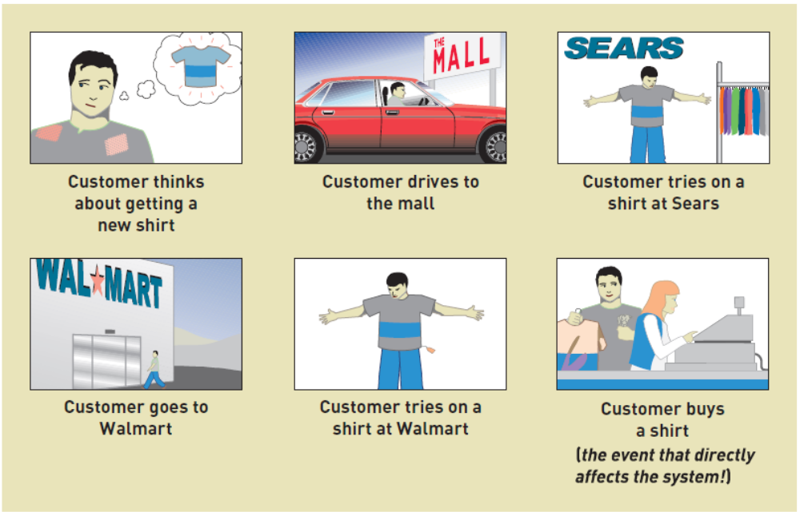
Finding the actual event that affects the system
Systems Analysis and Design in a Changing World, 6th Edition

Slide 16
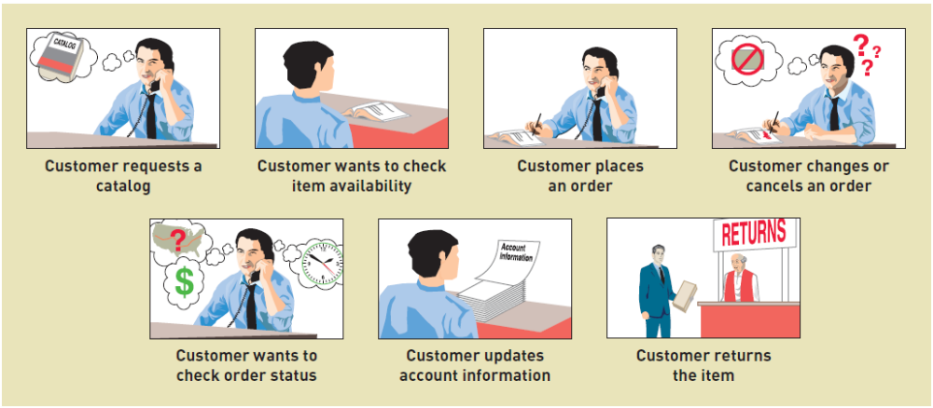
Tracing a sequence of transactions resulting in many events
Systems Analysis and Design in a Changing World, 6th Edition

Slide 17
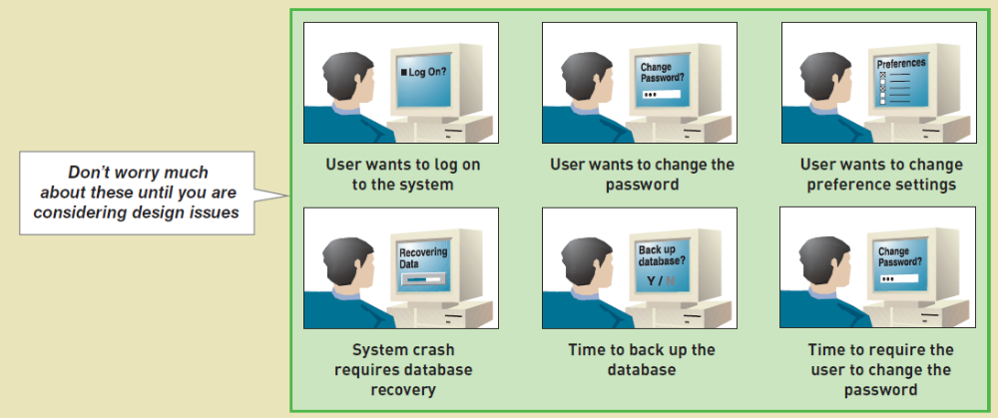
Perfect Technology Assumption
Don’t worry about functions built into system because of limits in technology and people. Wait until design.
Systems Analysis and Design in a Changing World, 6th Edition

Slide 18
Event Decomposition Technique:
Specific Steps
Consider the external events in the system environment that require a response from the system. E.g.
  An external agent wants something resulting in a transaction or wants information from system
  Data are changed and need to be updated (in DB)
  Management wants information
For each external event, identify and name the use case that the system requires
Systems Analysis and Design in a Changing World, 6th Edition

Slide 19
Event Decomposition Technique:
Specific Steps (continued)
Consider the temporal events that require a response from the system
  Internal reports needed
    Management, operational & Statements
For each temporal event, identify and name the use case that the system requires and then establish the point of time that will trigger the use case
Systems Analysis and Design in a Changing World, 6th Edition

Slide 20
Event Decomposition Technique:
Specific Steps (continued)
Consider the state events that the system might respond to, particularly if it is a real-time system in which devices or internal state changes trigger use cases.
For each state event, identify and name the use case that the system requires and then define the state change.
When events and use cases are defined, check to see if they are required by using the perfect technology assumption. Do not include events that involve such system controls as login, logout, change password, and backup or restore the database, as these are put in later.
Systems Analysis and Design in a Changing World, 6th Edition

Slide 21
Event Decomposition Technique: Benefits
Events are broader than user goal: Capture temporal and state events
Help decompose at the right level of analysis: an elementary business process (EBP)
EBP is a fundamental business process performed by one person, in one place, in response to a business event
Uses perfect technology assumption to make sure functions that support the users work are identified and not additional functions for security and system controls
Systems Analysis and Design in a Changing World, 6th Edition

Slide 22
Use Cases and CRUD Technique
CRUD is Create, Read/Report, Update, and Delete (archive)
Often introduced in database context
Technique to validate, refine or cross-check use cases
NOT primarily for identifying use cases
Systems Analysis and Design in a Changing World, 6th Edition

Slide 23
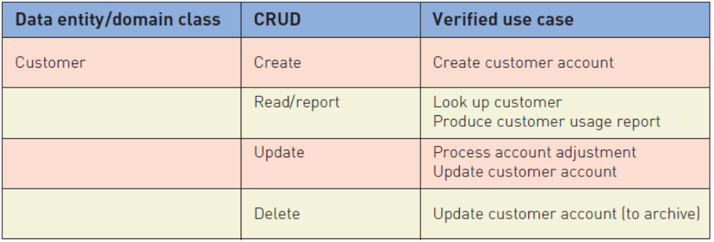
Use Cases and CRUD Technique
For Customer domain class, verify that there are use cases that create, read/report, update, and delete (archive) the domain class
Systems Analysis and Design in a Changing World, 6th Edition

Slide 24
CRUD Technique
Steps
Identify all the data entities or domain classes involved in the new system. (more in Chapter 4)
For each type of data (data entity or domain class), verify that a use case has been identified that: creates, updates, reads or reports, and deletes (archives) instances of that data entity.
If a needed use case has been overlooked, add a new use case and then identify the stakeholders.
With integrated applications, make sure it is clear which application is responsible for adding and maintaining the data and which system merely uses the data.
Systems Analysis and Design in a Changing World, 6th Edition

Slide 25
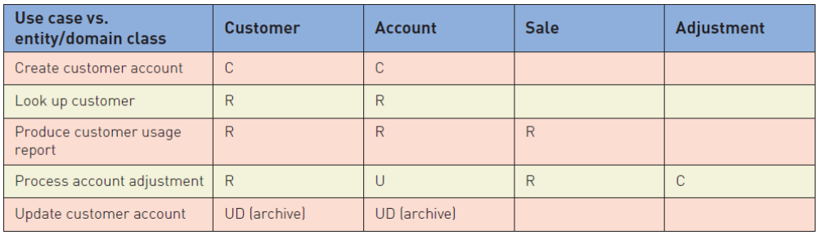
CRUD Technique
Use Case vs. Domain Class Table
To summarize CRUD analysis results, create a matrix of use cases and domain classes indicating which use case C, R, U, or D a domain class
Systems Analysis and Design in a Changing World, 6th Edition

Slide 26
Use Cases and
Brief Use Case Descriptions
Brief use case description is often a one sentence description showing the main steps in a use case
Systems Analysis and Design in a Changing World, 6th Edition

Slide 27
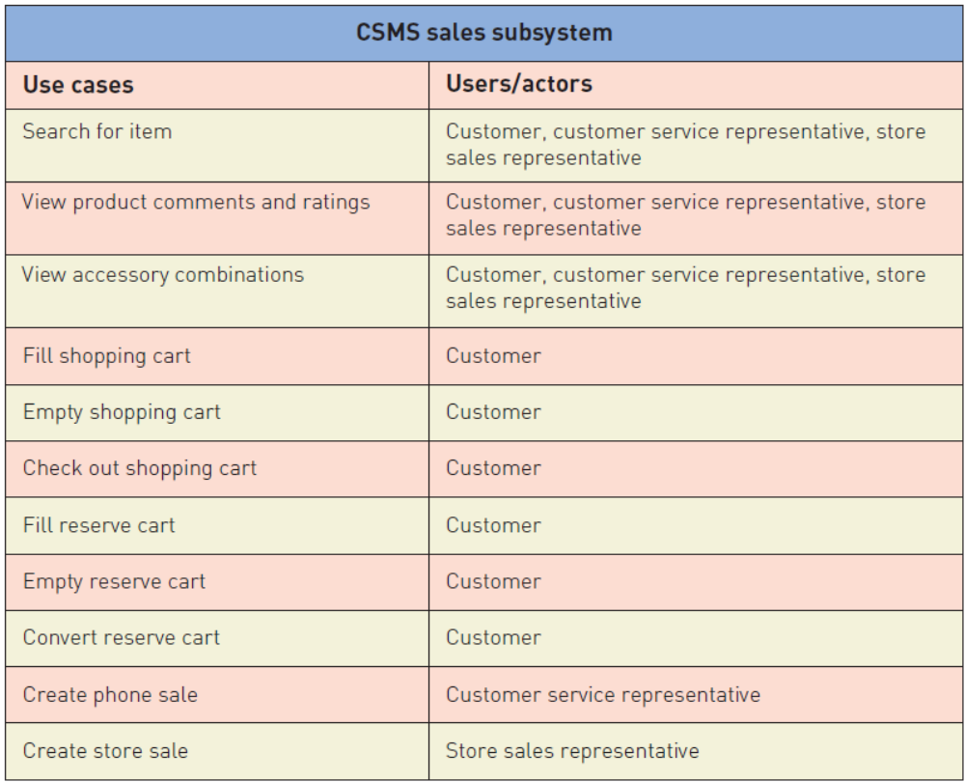
RMO CSMS Project Use Cases
Systems Analysis and Design in a Changing World, 6th Edition

Slide 28
Use Case Diagrams
Use case diagram— a UML model used to graphically show uses cases and their relationships to actors
Recall UML is Unified Modeling Language, the standard for diagrams and terminology for developing information systems
Actor is the UML name for a end user
Automation boundary— the boundary between the computerized portion of the application and the users who operate the application
Systems Analysis and Design in a Changing World, 6th Edition

Slide 29
Use Case Diagrams
Symbols
Systems Analysis and Design in a Changing World, 6th Edition

Slide 30
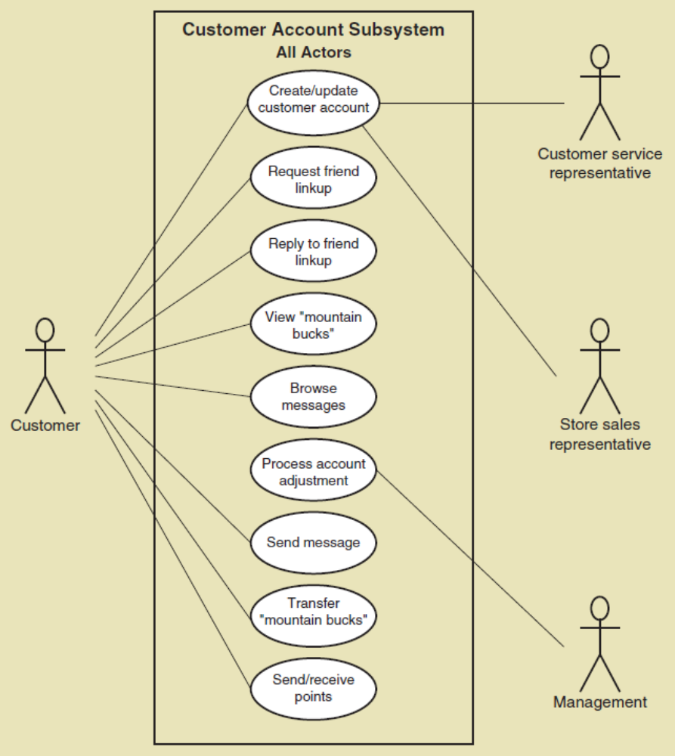
Use Case Diagrams
Draw for each subsystem
Systems Analysis and Design in a Changing World, 6th Edition

Slide 31
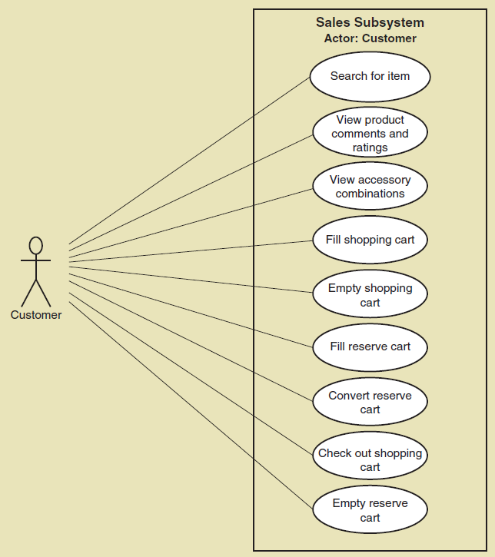
Use Case Diagrams
Draw for actor, such as customer
Systems Analysis and Design in a Changing World, 6th Edition

Slide 32
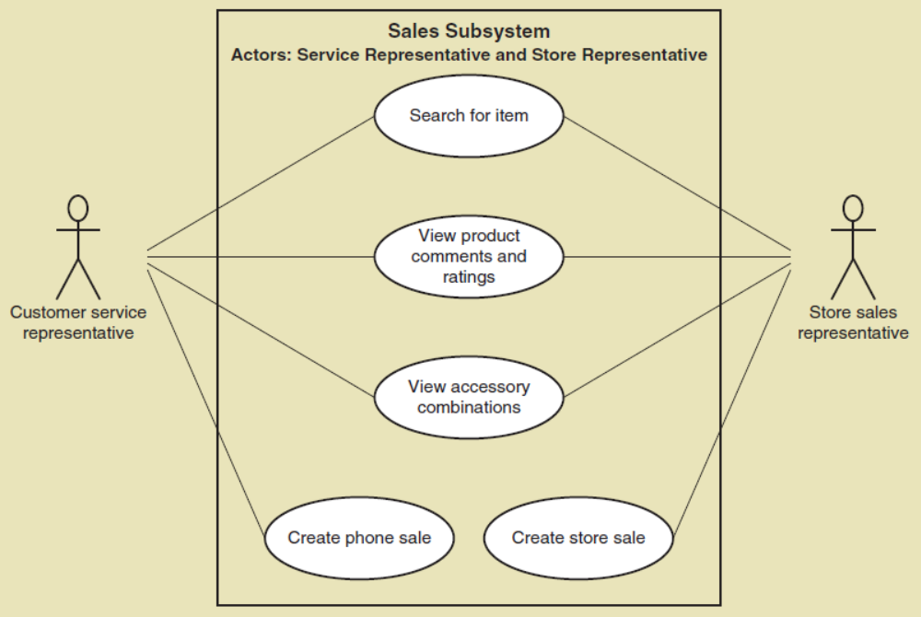
Use Case Diagrams
Draw for internal RMO actors
Systems Analysis and Design in a Changing World, 6th Edition

Slide 33
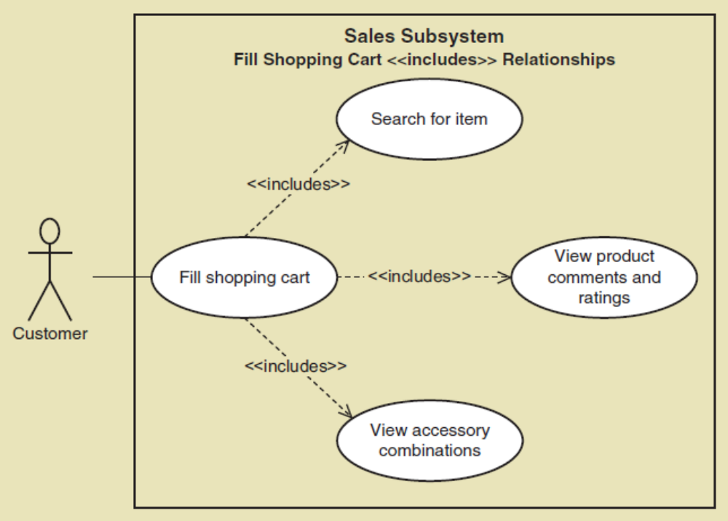
Use Case Diagrams
The <<Includes>> relationship
A relationship between use cases where one use case is stereotypically included within the other use case— like a called subroutine. Arrow points to subroutine
Systems Analysis and Design in a Changing World, 6th Edition

Slide 34
Use Case Diagrams:
Steps
Identify all the stakeholders and users who would benefit by seeing a use case diagram
Determine which use cases each stakeholder or user needs to
For each potential communication need, select the use cases and actors to show and draw the use case diagram. There are many software packages that can be used to draw use case diagrams
Carefully name each use case diagram and then note how and when the diagram should be used to review use cases with stakeholders and users
Systems Analysis and Design in a Changing World, 6th Edition

Slide 35
Summary
Use cases are the functions identified, the activities the system carries out usually in response to a user request
Two techniques for identifying use cases are the user goal technique and the event decomposition technique
  The user goal technique begins by identifying end users called actors and asking what specific goals they have when interacting with the system
  The event decomposition technique begins by identifying events that occur that require the system to respond.
    Events include external, temporal, and state events
Systems Analysis and Design in a Changing World, 6th Edition

Slide 36
Summary
Brief use case descriptions are written for use cases
The CRUD technique is used to validate and refine the use cases identified
The use case diagram is the UML diagram used to show the use cases and the actors
The use case diagram shows the actors, the automation boundary, the uses cases that involve each actor, and the <<includes>> relationship.
A variety of use case diagrams are drawn depending on the presentation needs of the analysis
Systems Analysis and Design in a Changing World, 6th Edition

